Slide 1
Loyola University Chicago
Stritch School of Medicine
Office of Student Affairs
CLASS OF 2025
INTRODUCTION TO
FOURTH YEAR
SCHEDULING & PLANNING

Slide 2
Agenda
Fourth Year & Clerkship Track System
Lottery Process
Required clerkships
Elective requirements, registration & VSLO
USMLE Step 2 requirements & timing
Residency Planning: Future Meetings
Online Resources

Slide 3
Handout (online)
Clerkship Track System and its Policies
Lottery Timeline
Timeline for Elective Registration Calendar
Information about Fourth Year Calendar
Information about computer generated Lottery Numbers

Slide 4
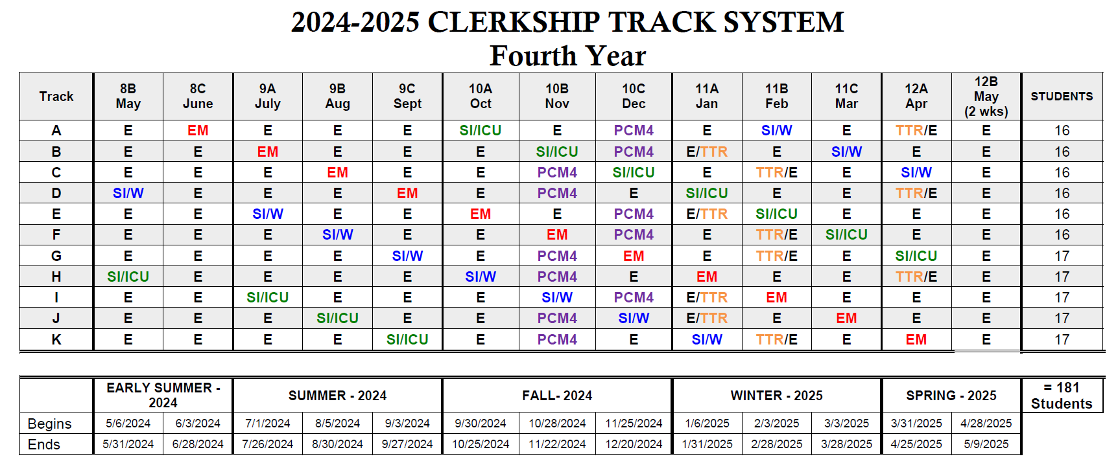

Slide 5
Calendar
Year 4 start date: First period block starts Monday, May 6th, 2024 (May = Period “8B”).
Summer Break at end of July (7/27/24 - 8/4/24) and Winter Break at end of Fall Semester (12/21/24 - 1/5/25).
Match Day and Graduation dates are tentative.
  Match Day tentatively March 21st, 2025.
  Graduation tentatively either on Sat. May 10th or 17th, 2025 (Commencement calendar will be finalized by LUC in Fall 2024).

Slide 6
Fourth Year
Overview of Requirements
12 weeks of core clerkships:
  Emergency Medicine, Sub-I Wards, Sub-I ICU
4 weeks required PCM-4 course (Nov or Dec)
2 weeks required Transition to Residency Bootcamp (TTR) (Offered in Jan, Feb or April in either first or second half of month.)
22 weeks of elective credit required for graduation
  32 weeks elective time available in M4 year for most students
  Must complete at least 12 weeks of clinical electives in M4 year
  Must complete at least 12 weeks of full-time coursework in final semester (full-time required clerkships or elective courses)
Bioethics Requirements
USMLE Step 2 CK

Slide 7
Introduction- Laura Ozark, MD
Who I am/how I got here/what I do at Loyola
Role as Assistant Educational Dean (CYD4)
Course Director for PCM-4
A resource for all M4 students
Single Goal:
  Ensure every M4 is prepared to start a rigorous intern year

Slide 8
Your M4 Year-
Readiness for Residency
Mix of required rotations and elective opportunities
Required:
  Sub-Intern Ward
  Sub-Intern ICU
  Emergency Medicine
  PCM-4 in Nov or Dec
  Transition to Residency (Bootcamp) 2 weeks

Slide 9
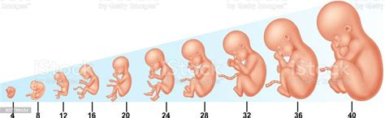
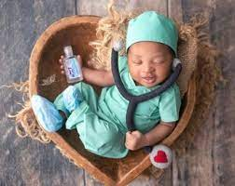
How long are the required elements of your M4 year?
40 weeks!
What takes 40 weeks?

Slide 10
Fourth Year
Overview of Requirements
12 weeks of core clerkships
4 weeks PCM-4
2 weeks TTR Bootcamp
---------------
18 weeks out of 50 weeks
12 weeks minimum of clinical electives
Bioethics Requirements
USMLE Step 2
Discretionary Time
Must complete at least 12 weeks of full-time coursework in final semester

Slide 11
Readiness for Residency M4
Core Rotations
3 Core Clerkships:
  Sub-Intern Wards
  Sub-Intern ICU
  Emergency Medicine

Slide 12
Purpose of Sub-Internships
Focus on skills and attitudes necessary to care for hospitalized and critically ill patients
Sub-I is about taking care of patients and assuming the responsibilities of the PGY1 resident
  You should minimize your time away from patient care duties
Emphasis is on patient care in the context of wards or ICU; emphasis is not on the specialty
Thus, Sub-Internships are posted on SSOM transcript without specialty noted (i.e., transcript reads only “Sub-Intern Wards” and “Sub-Intern ICU”)

Slide 13
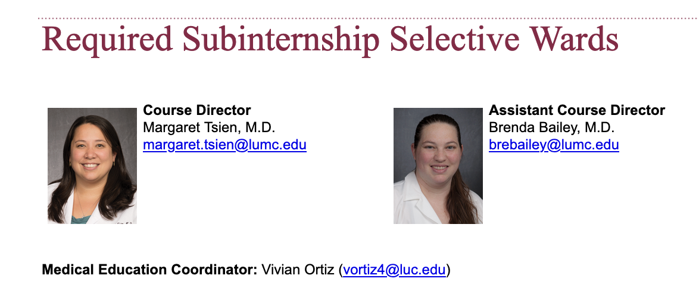
M4 Required Clerkships:
Sub-I Wards
4-weeks: inpatient service (“Sub-I Wards”)
  Examples of services: Gen Med, OB, Cardiology, Hem/Onc, Surgery, Peds
  Loyola, Gottlieb, Hines, Resurrection, Palos
Option for approval for external site (ie audition)
Lumen/Sakai has details

Slide 14
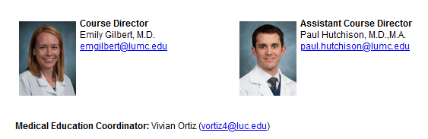
M4 Required Clerkships:
Sub-I ICU
4-weeks: intensive care unit (“Sub-I ICU”)
  Examples of services: MICU, SICU, BICU, CCU, NICU, PICU
  Loyola, Hines, Gottlieb, Resurrection
  Site selection based on your eventual residency

Slide 15
External Sub-Internships
Student can submit a petition to the SSOM registrar and Sub-I directors to complete the clinical component of 1 of the 2 required Sub-Is external to SSOM.
Must be submitted 60 days prior
  There will be no exceptions to this 60-day rule.
Must be in same month as assigned Sub-I rotation
Sub-I Requirements for external sites are on LUMEN for your review.

Slide 16
External Sub-Internships
In general, the external Sub-I offering must:
  have well-developed educational objectives with clear oversight;
  be a primary service directly responsible for patient care;
  be predominantly an inpatient service;
  place student in a position to take primary responsibility for patient care
General rule of thumb: external Sub-I experience must mirror those offered at SSOM
Still required to go through SSOM orientation, OSCE, and other required activities

Slide 17
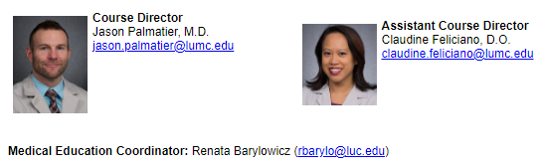
M4 Required Clerkships:
Emergency Medicine
4-week rotation
11, 8-hour shifts which occur all hours of the day and days of the week
Located at Loyola and Hines, MacNeal, or Gottlieb
3 required educational days, plus 2 OSCE days, plus exam, plus other assignments as instructed
Cannot miss any of the required educational days, OSCE or exam

Slide 18
Emergency Medicine
Shift start/end times are not flexible and students are expected to be present for each full, 8-hour shift
Unexcused shift absences are made up after the final exam
Policies regarding time off, shift swaps
  Available on Lumen. Make sure you understand these rules.
  Primary information always better than “word of mouth”

Slide 19
Required Rotation:
Patient-Centered Medicine-4
Offered in November or December
Asynchronous curriculum allowing time for interviewing while providing additional training in transition to intern year
Can swap November and December only if no required rotation in opposite month
Online, with several Live Zoom sessions
The course is pass/fail/meets with concern

Slide 20
PCM-4
Interviews should be prioritized during this month
You cannot be enrolled in 2 rotations at the same time
  You cannot do an audition/extramural rotation and PCM-4 at same time
  Calendars are challenging between institutions. 7 day overlap allowed, more time needs approval from LO
Keep a calendar and plan your time

Slide 21
Readiness for Residency:
Transition to Residency (TTR)
Bootcamp best done in medical school
Situated in the final semester of medical school
Content geared both general and specialty-specific
2 weeks in length, offered 2 weeks of 11A, 11B, 12A
Residency programs like this/increasingly expecting this experience

Slide 22
Transition to Residency (TTR)
Tracks have the TTR and E(lective) listed in the order it is being offered (TTR/E vs E/TTR)
TTR sessions are focused toward residency-specific topics (medicine/pediatrics/surgical)
  Adult medicine specialties should choose the TTR in Tracks:
    11A or 11B for best experience
  Pediatric focused specialties should choose the TTR in Tracks:
    11A or 11B for best experience
  Surgical specialties should choose the TTR in Tracks:
    11B or 12A for best experience
Switching sessions for TTR will be subject to availability (should not count on it)

Slide 23
FYI-
Capstone Transition OSCE
Capstone demonstrating clinical skills, assessment and write-ups
Personalized assessment and feedback
  Teamwork and communication skills
  Clinical decision making
  Management of an unstable patient
  NOT the same as end of life OSCE
One 4-hour session:
  Dates TBD: March-April of THIS academic year

Slide 24
Readiness for Residency
Formation
40 weeks to create a child. 40 weeks to prepare for your intern year.
Be thoughtful in creating your academic plan
$62,530/10=$6,253 per month during M4 year
You are your best investment
Resources available to help advise

Slide 25
Bioethics Requirement
Ethics case paper due in Yr 3: Friday, March 22, 2024 by 4:00 pm
  More details found here.
Four Ethics Grand Rounds must be completed cumulatively over 1st - 4th years
  Completion of Ethics Grand Rounds (min. of 4 sessions total by end of fourth year)

Slide 26
Readiness for Residency: Electives
Purpose
  Broadens & strengthens clinical experience
  Tests interest in an area of specialization
  Provides research or special opportunities
  Promotes self determination and responsibility for content of program
Notes:
These next series of slides will be talking about Electives because they make up a good portion of your M4 year you may want to have this information when choosing tracks.

Slide 27
Building Your Elective Program Content
Reflect on gaps in your knowledge or skillset
Talk to faculty and specialty advisor(s)
Attend specialty department sessions and ask questions
Talk to faculty in your field(s) of interest
See Dean Mendez and Dean Martinez for input
Attend Students Advising Students (SAS) programs
Springtime will have more information

Slide 28
Readiness for Residency: Electives
22 weeks of elective credit required for graduation
  Up to 4 weeks part-time credit from M1/M2 years (combined) and part-time credit from M3/M4 years (combined) may be accrued
32 weeks available elective time in M4 year
  Calendar shows 7 full months with “E” plus 2 weeks opposite TTR and 2 weeks in 12B (Apr/May)
Most electives are 4 weeks in length
  There are several 2-week electives available
In your M4 year, your elective program must include at least 12 weeks clinical electives (2 or 4 weeks)
  Clinical vs Non-clinical electives
Course Descriptions online in SSOM Elective Catalog

Slide 29
Electives (continued)
12 weeks of elective time permitted away (“extramurals/away rotations/audition rotations”)
12 weeks permitted in any specialty (in M4 year)
  Excludes time in core clerkships in the specialty
  Excludes M3-year elective
  Includes electives at Loyola and away
  Exceptions include Cardiographics, Medical Teaching, etc.
Consider Individually Designed Elective
  Details on elective website
  Must be approved by Dr. Ozark and Registrar
Other elective policies in catalog preface

Slide 30
Elective Registration Process
Intramurals (Loyola)
Review course descriptions & policies in elective catalog online
Online elective registration through myLUMEN
Sign up starts about 4 months in advance of each elective month’s start date
More info from ORR closer to first opening registration date (Mid-January)

Slide 31
Externships (a.k.a. extramural electives, away rotations)
Up to 12 weeks permitted usually through another US med school
Loyola sign up Timetable does NOT apply
Reference AAMC Extramural Elective Compendium and/or VSLO for timeline, websites, contact person at site.
Beware that their calendar could be very different from ours. Students are responsible for keeping track of beginning and start dates of rotations.
  Rotations cannot overlap
Sign up 1 – 5 months in advance of start date; typically April – mid-May for summer courses.
CHECK YOUR EXTRAMURAL SITE’S SIGN UPDATE AND APPLICATION REQUIREMENTS!

Slide 32
Purpose of Externships
To get an excellent learning experience
To help narrow specialty interests
To see a program of interest first hand
To work with an outstanding faculty
To show your stuff and perhaps get a recommendation letter
To assess a program’s compatibility with your needs
To do unique non-hospital based experiences

Slide 33
Visiting Student Learning Opportunities (VSLO)
Web-based application platform developed by the AAMC.
Greater than 3/4th of US medical schools use VSLO to process visiting student applications; the others use their own applications.
Registration & Records will upload transcripts and certify applications after you have applied to one or more electives.
Registration & Records will “Release” applications on VSLO.

Slide 34
Do you need to do 3 externships (12 weeks)?
It depends…
  On your interests, profile, specialty field and geographical considerations
  Most students should do one or two
  Some specialties discourage more than one elective in the field; others promote student enrollment in several. SEEK ADVICE!

Slide 35
Outside elective recommendations vary by specialty
We queried our PDs from all residencies re: opinion on away rotations
  No consistent answer: 0-3
  Link to Google Sheet
We’ve been meeting with our individual PDs the last year and collected useful residency application information to help Stritch students become excellent applicants.
  We will provide this information the class at January presentation.
Notes:
I know you can’t read this but

Slide 36
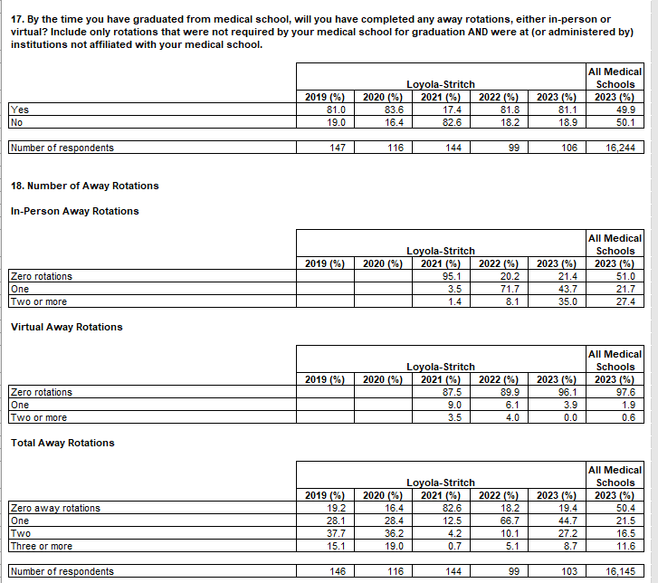
SSOM student data- GQ2023

Slide 37
Extramural Registration
Review policies in SSOM catalog
Review visiting student policies on other school’s website
Application
  online: Visiting Student Learning Opportunities (VSLO) OR
  paper/PDF: Non-VSLO institutions - application packet must submitted through SSOM Registration & Records Office and get Dean’s approval. See Rosemary Calcagno (rcalcagno@luc.edu) in Rm 220 for packet/instructions.

Slide 38
Extramural Registration for schools not using VSLO
See (or email) Rosemary Calcagno in Registration & Records for application packet.
Complete Loyola’s extramural application AND other institution’s Visiting Student Application.
Often possible to list more than one date or several elective preferences.
Compile supporting documents; submit to Rosemary in Registration & Records.
A Student Affairs Dean will review and approve application; application packet will then be sent to extramural school.

Slide 39
Extramural Registration additional documentation (submitted via VSLO or by paper)
Typical Supporting documents
Proof of liability coverage
Current immunization record
Confirmation of UP/OSHA/HIPAA training
Proof of hospitalization insurance
SSOM transcript
Possibly faculty/dean’s letter of recommendation
Possibly criminal background check record
Possibly affiliation agreement? Memo of Understanding?

Slide 40
Elective Add/Drop Policy
Add: register for electives at least one month prior to start date
Drop (Loyola courses): at least one month prior
Drop (Extramurals): according to other institution’s policy, typically at least 4-5 weeks prior.

Slide 41
Discretionary Time Use
Time for Additional Elective Opportunities OR
For USMLE Step 2 study time
Residency Interview time off
For extramural calendar adjustment (other school’s calendar doesn’t match Stritch’s)
For remediation needs
For personal needs

Slide 42
Applying for Discretionary Time Off
May be taken in one week or longer increments
Request must be submitted in advance
Submit Discretionary Time requests through myLUMEN Elective Registration page

Slide 43
USMLE STEP 2 CK
First attempt CK exams be taken by the end of fall semester of fourth year (by December 31, 2024)
Residency programs increasingly want proof of successful completion of Step 2 during interview process; majority want proof of passing before ranking candidates (i.e., score needed by mid-January 2025 for the Match)
USMLE Step 2 CK must be PASSED to graduate. If a 2nd attempt is needed, scores must be received at least two months prior to graduation (mid-March 2025).
Scores reported approximately 2-3 weeks after test date.

Slide 44
4th Year Goals by Season
Focus of each quarter
  Early Summer (May/June)
  Summer
  Fall
  Winter
  Spring

Slide 45
Summer Goals (May/June/July/Aug/Sept)
Solidify specialty interest
May/may not need to take specialty elective at Loyola to earn a recommendation letter (depends on prior exposure)
Summer work may bump up performance level
Courses provides prep for important externships
May need to study weeks/month for USMLE Step 2 prep
Preparation of residency application starts
Externships start
Complete Step 2 study and take CK (more on this later)

Slide 46
Fall Goals (Oct/Nov/Dec)
Dean’s Letters released Sept 25th, 2024 (tentative date - NOT FINAL)
Externships continue
Residency interview season kicks in; will you need time off? Should you take DT?
Sept/Oct courses could still produce residency recommendation letters
PCM-4 in Nov or Dec
Complete Step 2 study and take CK (more on this later)

Slide 47
Winter Goals (Jan/Feb/Mar)
Finish interviewing
Take courses to round out your education
Prepare for starting a residency (what do you still need to learn?)
Rank residencies for match (mid Jan - late Feb)
International elective?
Transition to Residency Bootcamp (TTR)

Slide 48
Spring Goals (Apr/May)
Take enrichment courses
International elective?
Transition to Residency Bootcamp (TTR)
Get tuition’s worth by staying enrolled
Take DT for personal/transitional use
Complete graduation requirements
Graduate!!!

Slide 49
Residency Planning
You may want to know now…

Slide 50
Residency Letters of Recommendation
Up to 4 letters for ERAS/NRMP programs; often only 3 are requested.
Up to three for early match programs
Request letters when opportunities present themselves
Submitted by writer directly through ERAS LOR portal (available by June)

Slide 51
CVs, etc.
Feedback on CV’s
Submit updated copy for Dean’s Letter use (exact due date this spring TBA)
Personal “noteworthy characteristics” will be needed for dean’s letter – (exact due date this spring TBA; instructions will be provided)

Slide 52
Online Resources
Loyola SSOM Elective Catalog: https://www.luc.edu/stritch/regrec/electivecatalog/coursecatalog/
AAMC Extramural Elective Compendium: https://services.aamc.org/eec/students/index.cfm
AMA-FREIDA (Residency program info): http://www.ama-assn.org/go/freida
Match info: http://www.nrmp.org/
Residency Web Application process: https://www.aamc.org/services/eras/
USMLE STEP 2 info: http://www.usmle.org/step-2-ck/
Visiting Student Learning Opportunities: https://vslo.aamc.org/vslo
Careers in Medicine: http://www.aamc.org/cim

Slide 53
Future Workshops
Residency Application Process – Everything You Wanted to Know about the MSPE
  Tuesday, January 16th, 5:30 – 7:00 pm (SSOM 190)
ERAS-Electronic Application Process
  TBD (Look out for an email with more information)

Slide 54
Ask Questions!
It is acceptable, expected, smart
Where:
  Registration & Records (changing your schedule, how to sign up for electives, policies)
  Student Affairs (what to take, when)
  Faculty Advisor (what, where, when)
  Specialty Advisor (where, when, how many)
  Elective dept. offices (how, which)

Slide 55
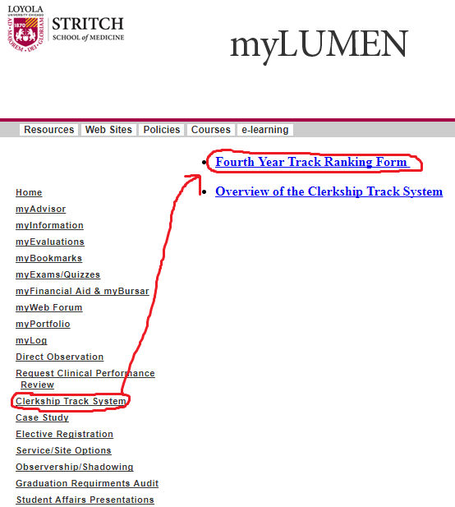
Submitting your Track Preferences
Go to myLUMEN>Clerkship Track System> Fourth Year Track Ranking Form
Ranking Form submission deadline is Wednesday, November 29th, 2023
If you encounter any problems, contact
Agape Lamberis (aglamberis@luc.edu)

Slide 56
Questions?

